Slide 1
EAS508-Presentation-1
Group22:
Anusha Kondle(Anushako)
Nabeel Khan(Nkhan6)
Mohit Mathur(Mohitmat)
Sunkara Charan Kumar(sunkara2)

Slide 2
introduction
Wildfires are one of the primary causes for loss of acres of land in the US. These lead to loss of vegetation of the forests and their inhabitants. Furthermore, release of toxic gases such as carbon monoxide, carbon dioxide and other toxic substances result in physiological as well as psychological health issues.

Slide 3
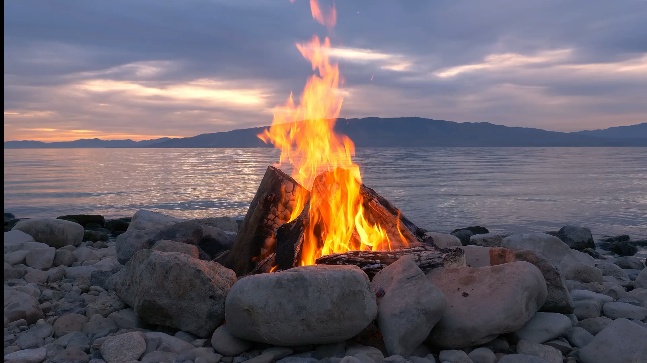
Wild fires analysis
Problem: Wildfires has been one of the most prominent disasters lately in the US- some of these being natural and the others being man-made. According to Wikipedia, more than 10.2million acres of land was burned in wildfires in the Western US alone! While this affects the vegetation of the forests and their inhabitants, there are more casualties and concerns. So, we thought of

Slide 4

Goal:
Some of the aspects we are interested in looking at is:
Visualizing the trends of wildfires over the 7years period.
Highlighting some common causes of the wildfires.

Slide 5
Dataset
For this, we found a spatial database of wildfire from 1990 – 2015, where in the data was acquired from Federal, State and Local fire organizations. The dataset is readily available in Kaggle website. Dataset contains 1.8million observations and 39 variables. Each column is an attribute that describes fire size, longitudes and latitudes of the location of the fire, date and time of the occurrence, causes of wildfires, etc. Data Reference: https://www.kaggle.com/rtatman/188-million-us-wildfires

Slide 6
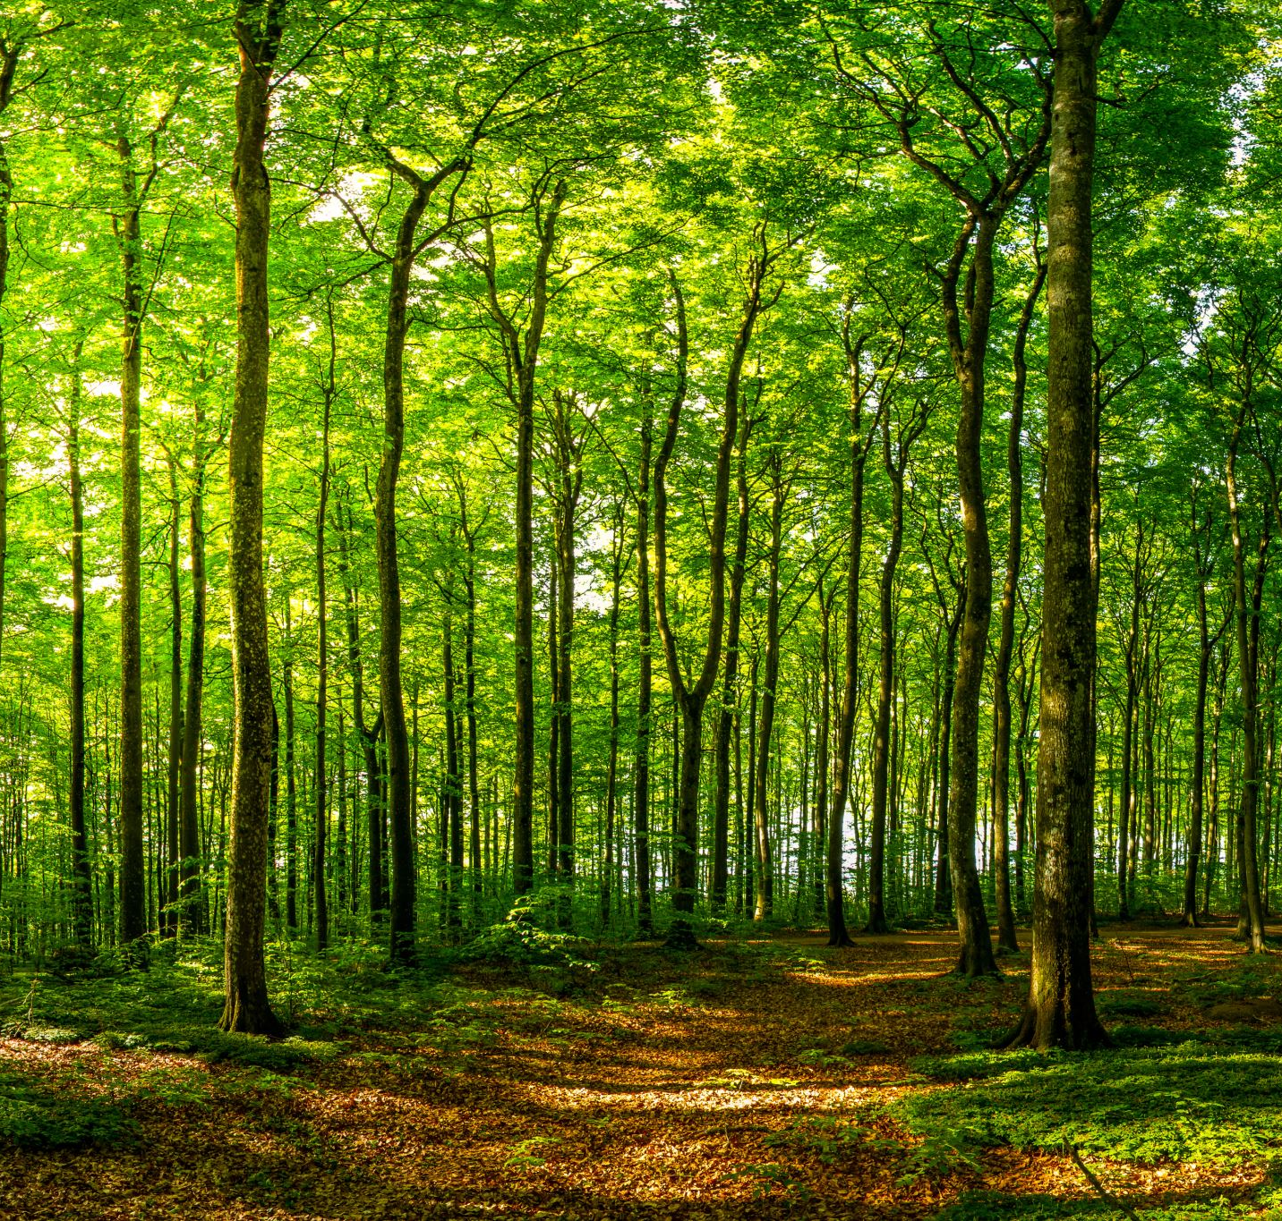
Implementation
EDA
Regression methods – Random Forest and Logistic Regression
Visualization
Matplotlib
Geopandas

Slide 7
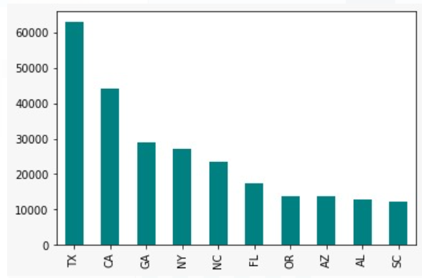
Exploratory Data Analysis

Slide 8
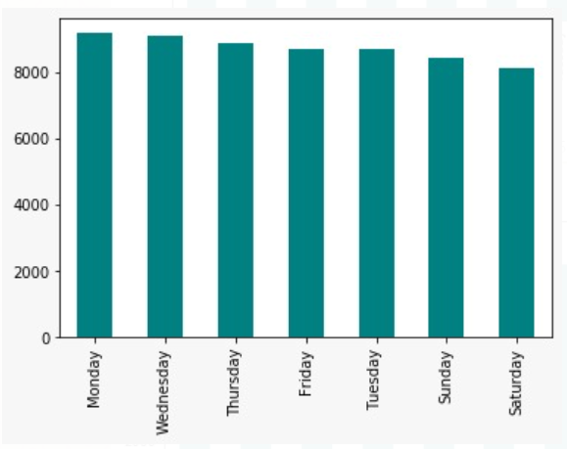
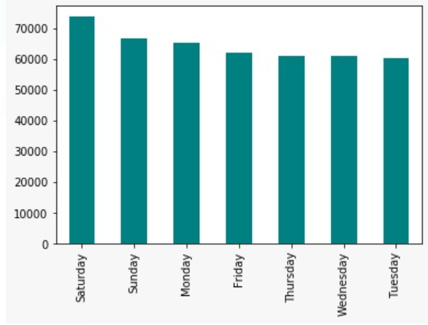
Number of correlation to the day of the week

Slide 9
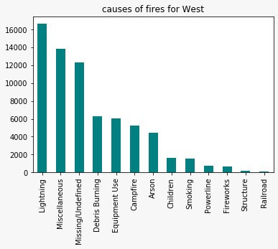
Wildfire analysis of the Western USA

Slide 10
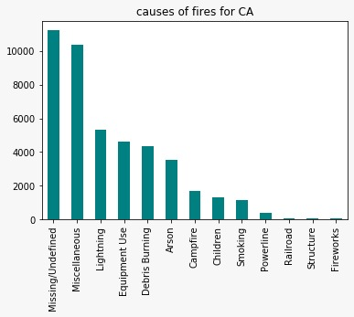
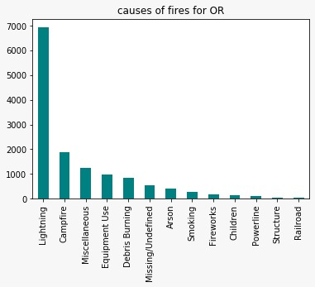
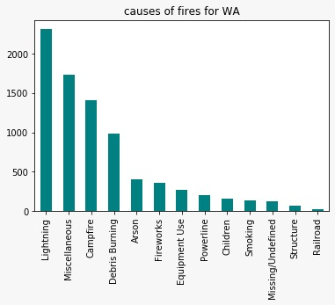
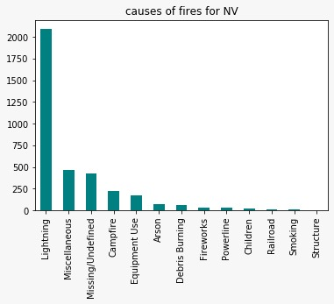
Causes of fires in CA,OR,NV,WA

Slide 11
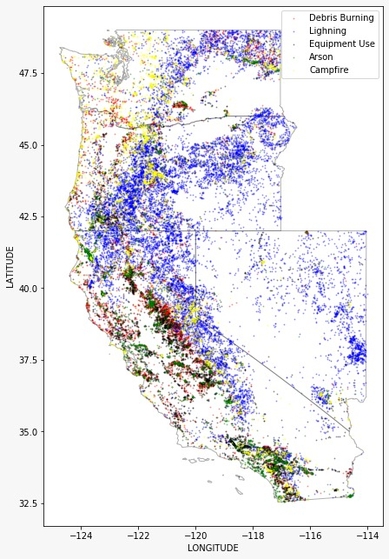
Wild fires Picture of Western USA

Slide 12
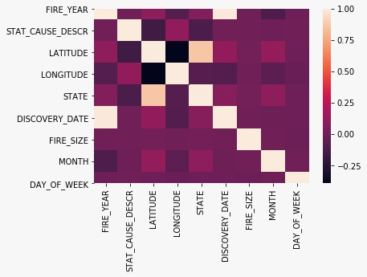
Correlation Plot

Slide 13
Challenges Faced in Project:
Importing Geopandas in Different environments i.e., on windows and mac and then, importing packages from it.
The type of dataset is concentrated on the Wildfires in US, specially on the western states. Therefore, the data is not available for different parts of the world.

Slide 14

Conclusion:
Result-
We have predicted the fire with 95.145% accuracy to be arson.

Slide 15
Future Scope
1. We can collect data throughout the world regarding Wildfires, both natural and man-made. This can help us in identifying the trend of Wildfire in different places and what all factors can be taken into consideration while predicting about them.
2. Forest Welfare can be promoted by making government factions aware about the wildfires by means of prediction models.
3. Protection and conservation of lands affected by previous wildfires can be proposed for afforestation.

Slide 16
Thank You

